Slide 1
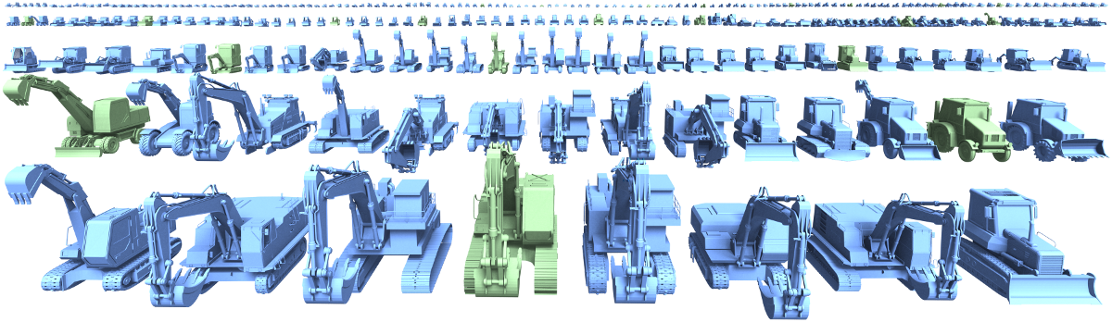
A Probabilistic Model for
Component-Based Shape Synthesis
Evangelos Kalogerakis, Siddhartha Chaudhuri,
Daphne Koller, Vladlen Koltun
Stanford University

Slide 2
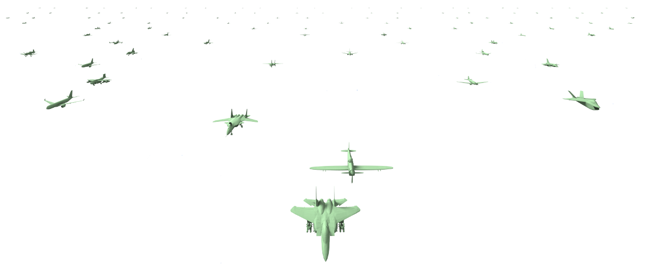
Goal: generative model of shape

Slide 3
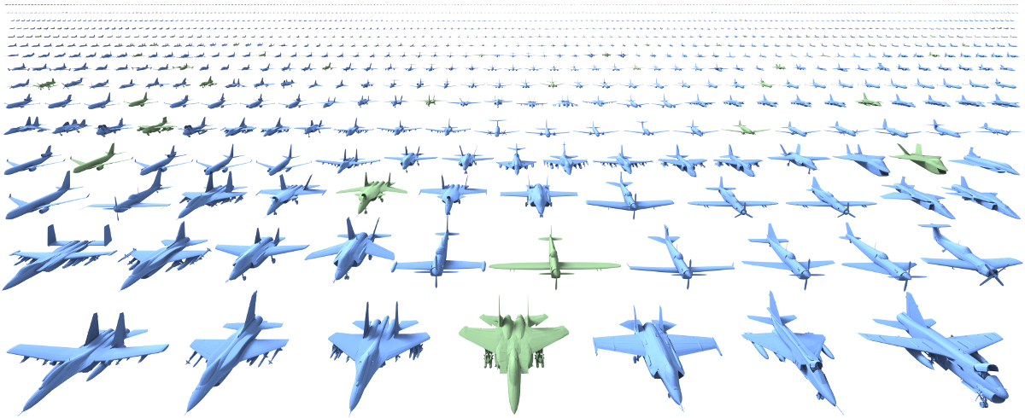
Goal: generative model of shape

Slide 4
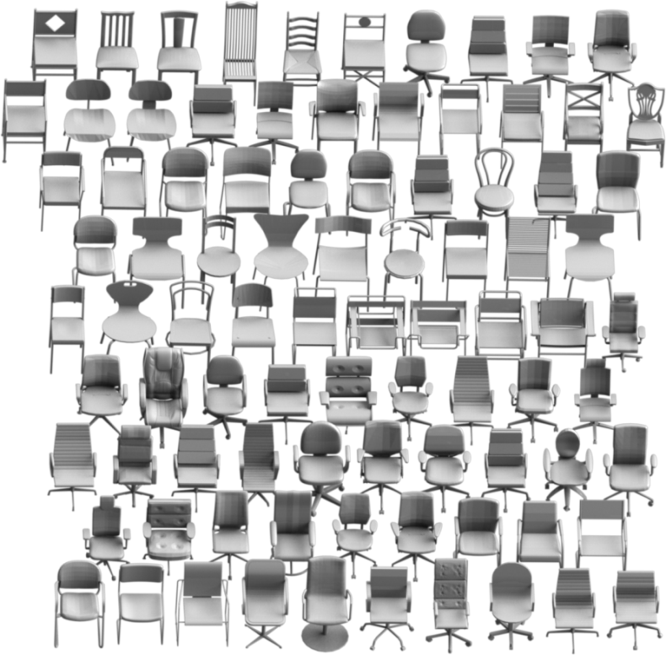
Challenge: understand shape variability
Structural variability
Geometric variability
Stylistic variability
Our chair dataset

Slide 5
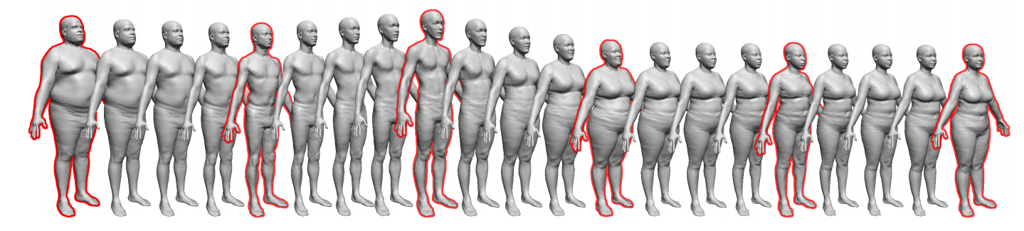
Related work: variability in human body and face
A morphable model for the synthesis of 3D faces [Blanz & Vetter 99]
The space of human body shapes [Allen et al. 03]
Shape completion and animation of people [Anguelov et al. 05]
[Allen et al. 03]
Scanned bodies

Slide 6
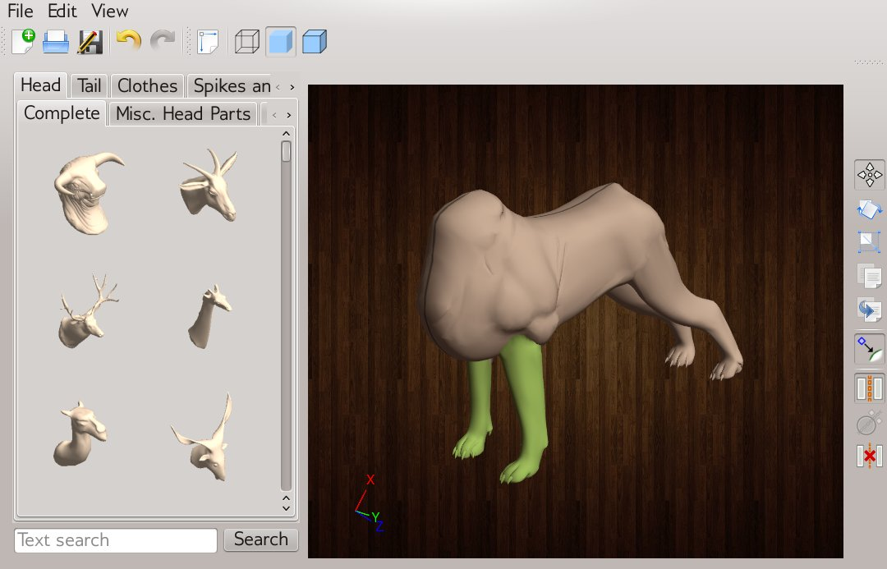
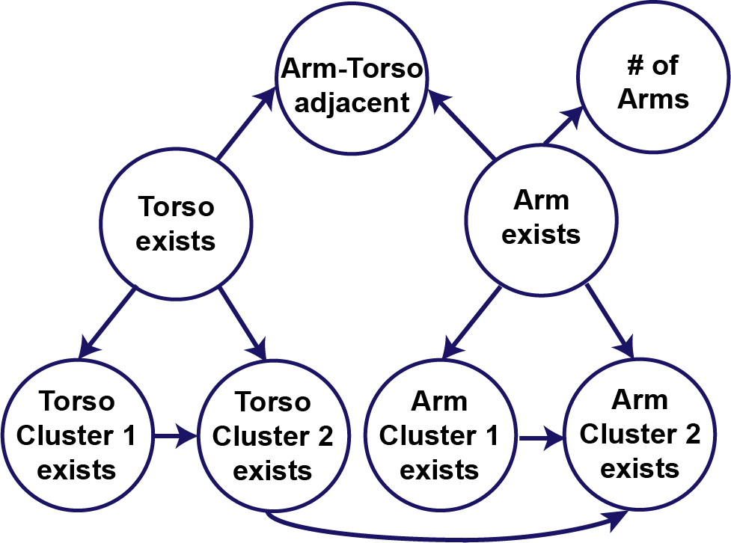
Related work: probabilistic reasoning for assembly-based modeling
[Chaudhuri et al. 2011]
Inference
Probabilistic model
Modeling interface

Slide 7
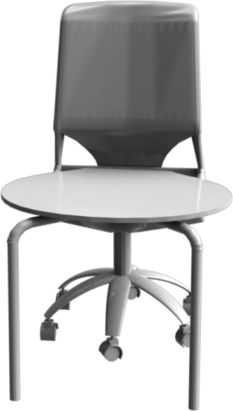
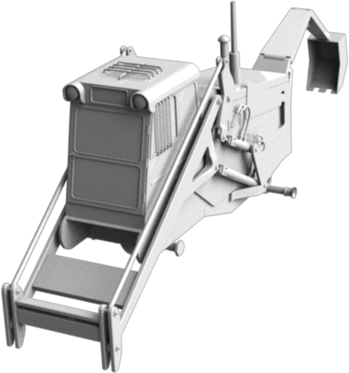
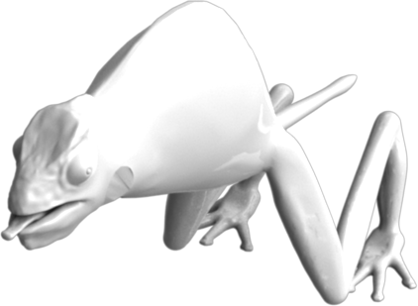
Related work: probabilistic reasoning for assembly-based modeling

Slide 8
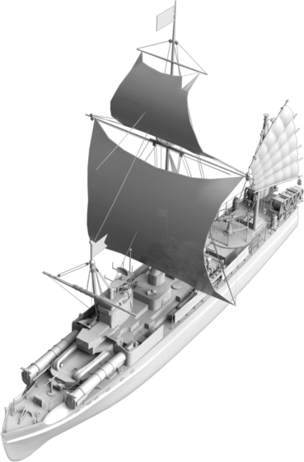
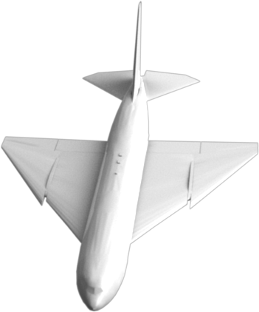
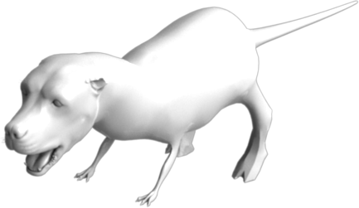
Randomly shuffling components of the same category

Slide 9
Our probabilistic model
Synthesizes plausible and complete shapes automatically

Slide 10
Our probabilistic model
Synthesizes plausible and complete shapes automatically
Represents shape variability at hierarchical levels of abstraction

Slide 11
Our probabilistic model
Synthesizes plausible and complete shapes automatically
Represents shape variability at hierarchical levels of abstraction
Understands latent causes of structural and geometric variability

Slide 12
Our probabilistic model
Synthesizes plausible and complete shapes automatically
Represents shape variability at hierarchical levels of abstraction
Understands latent causes of structural and geometric variability
Learned without supervision from a set of segmented shapes

Slide 13
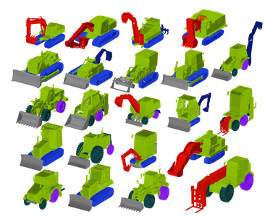
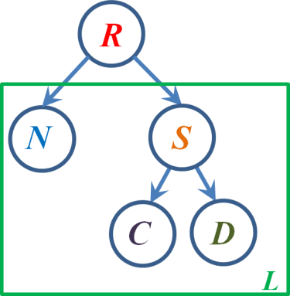
Learning stage

Slide 14
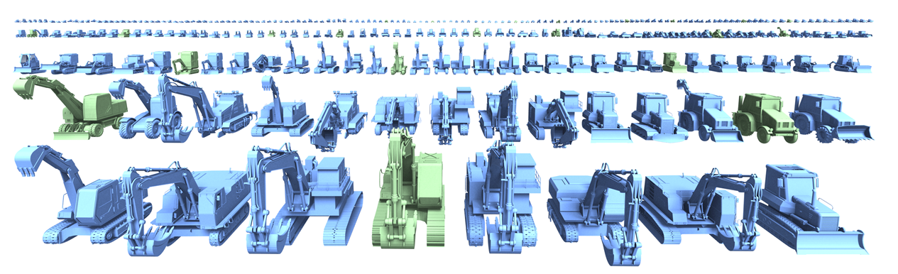
Synthesis stage

Slide 15
Learning shape variability
We model attributes related to shape structure:
Shape type
Component types
Number of components
Component geometry
P( R, S, N, G)

Slide 16
R
P(R)

Slide 17
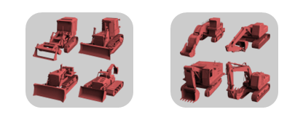
R
P(R)

Slide 18
R
N_{l}
L
Π
P(R) [P( N_{l} | R)]
l ∈ L

Slide 19
R
N_{l}
S_{l}
L
Π
P(R) [P( N_{l} | R) P ( S_{l} | R )]
l ∈ L

Slide 20



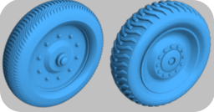
R
N_{l}
S_{l}
L
Π
P(R) [P( N_{l} | R) P ( S_{l} | R )]
l ∈ L

Slide 21
R
N_{l}
S_{l}
D_{l}
C_{l}
L
Π
P(R) [P( N_{l} | R) P ( S_{l} | R ) P( D_{l} | S_{l} ) P( C_{l} | S_{l} )]
l ∈ L

Slide 22
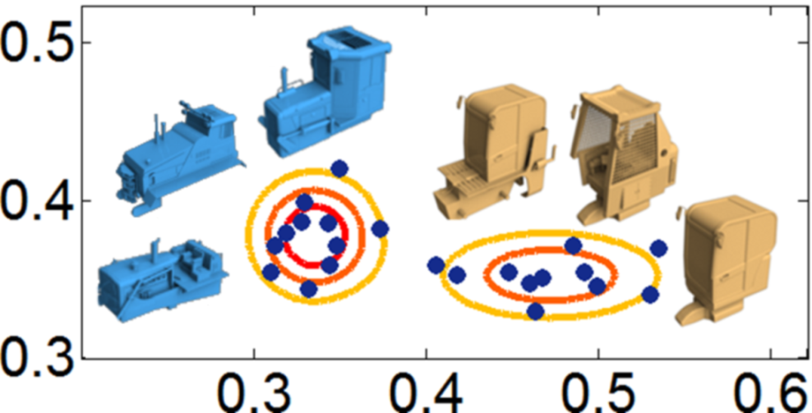
R
N_{l}
S_{l}
Width
D_{l}
C_{l}
L
Height
Π
P(R) [P( N_{l} | R) P ( S_{l} | R ) P( D_{l} | S_{l} ) P( C_{l} | S_{l} )]
l ∈ L

Slide 23
R
Latent object style
N_{l}
S_{l}
Latent component style
D_{l}
C_{l}
L
Π
P(R) [P( N_{l} | R) P ( S_{l} | R ) P( D_{l} | S_{l} ) P( C_{l} | S_{l} )]
l ∈ L

Slide 24
R
N_{l}
S_{l}
Learn from training data:
latent styles
lateral edges
parameters of CPDs
D_{l}
C_{l}
L

Slide 25
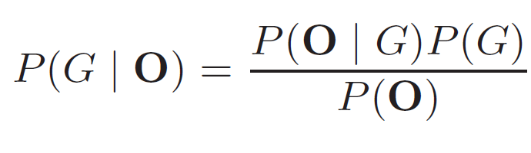
Learning
Given observed data O, find structure G that maximizes:

Slide 26
Learning
Given observed data O, find structure G that maximizes:

Slide 27
Learning
Given observed data O, find structure G that maximizes:

Slide 28
Learning
Given observed data O, find structure G that maximizes:

Slide 29
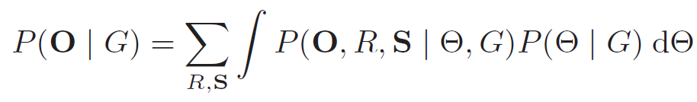

Learning
Given observed data O, find structure G that maximizes:
Assuming uniform prior over structures, maximize
marginal likelihood:
$$Θ$$

Slide 30
Learning
Given observed data O, find structure G that maximizes:
Assuming uniform prior over structures, maximize
marginal likelihood:
$$Θ$$
Complete likelihood

Slide 31
Learning
Given observed data O, find structure G that maximizes:
Assuming uniform prior over structures, maximize
marginal likelihood:
$$Θ$$
Parameter priors

Slide 32
Learning
Given observed data O, find structure G that maximizes:
Assuming uniform prior over structures, maximize
marginal likelihood:
$$Θ$$

Slide 33
Learning
Given observed data O, find structure G that maximizes:
Assuming uniform prior over structures, maximize
marginal likelihood:
$$Θ$$
Cheeseman-Stutz approximation

Slide 34
Our probabilistic model: synthesis stage

Slide 35
Shape Synthesis
Enumerate high-probability instantiations of the model
{}
{R=1} {R=2}
{R=1,S₁=1} {R=1,S₁=2} {R=2,S₁=2} {R=2,S₁=2}
…

Slide 36
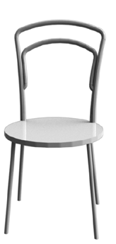
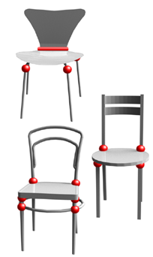
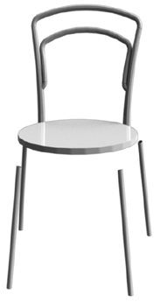
Component placement
Source
shapes
Unoptimized
new shape
Optimized
new shape

Slide 37
Database Amplification - Airplanes

Slide 38
Database Amplification - Airplanes

Slide 39
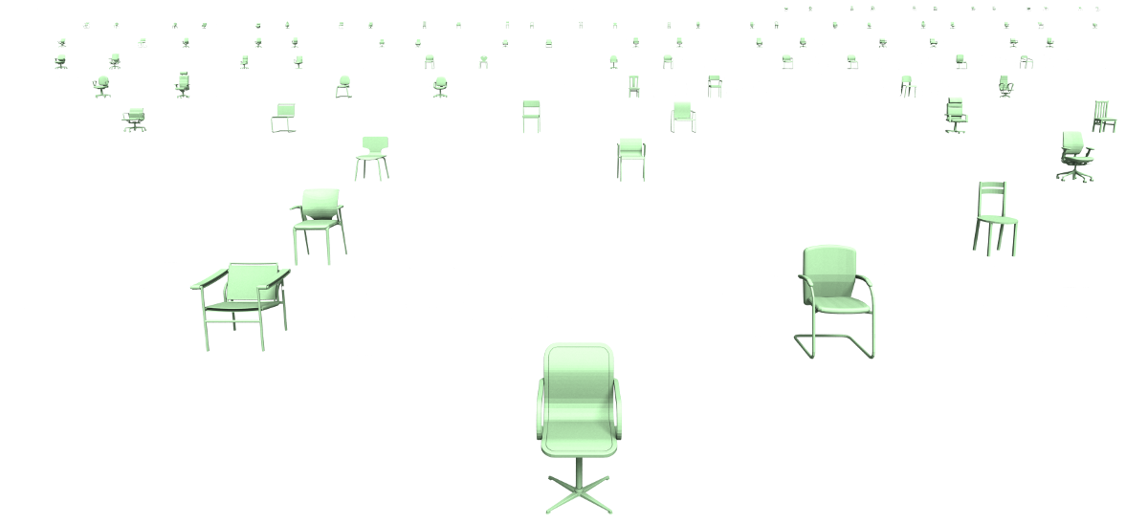
Database Amplification - Chairs

Slide 40
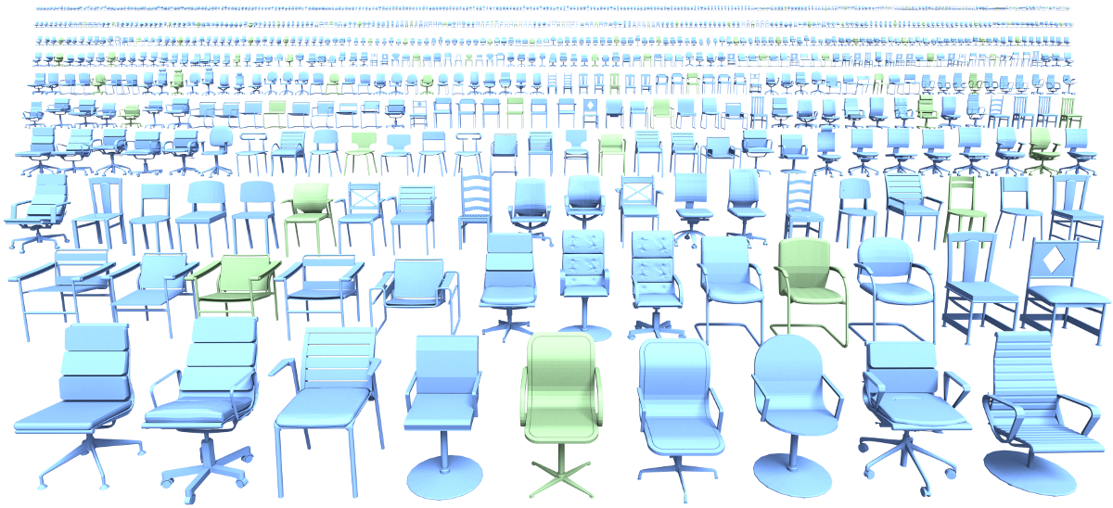
Database Amplification - Chairs

Slide 41
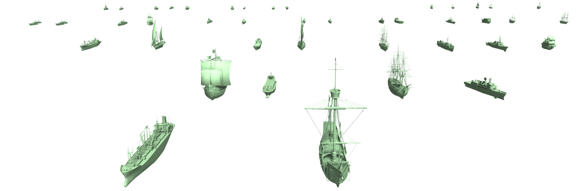
Database Amplification - Ships

Slide 42
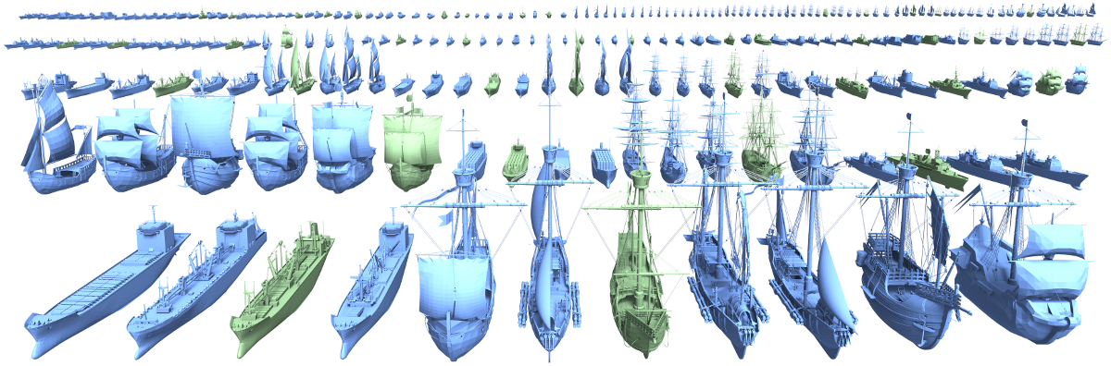
Database Amplification - Ships

Slide 43
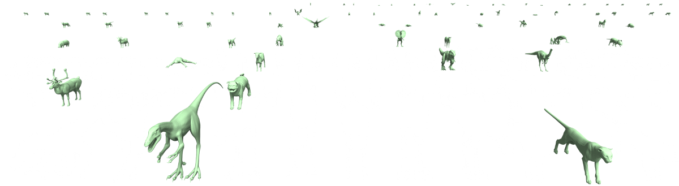
Database Amplification - Animals

Slide 44
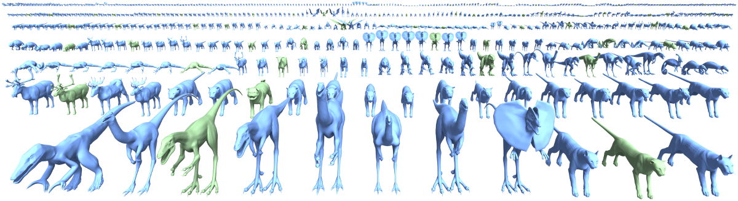
Database Amplification - Animals

Slide 45
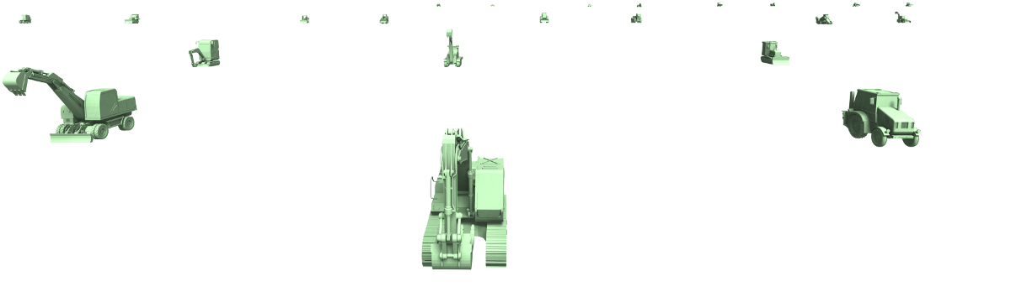
Database Amplification – Construction vehicles

Slide 46
Database Amplification – Construction vehicles

Slide 47
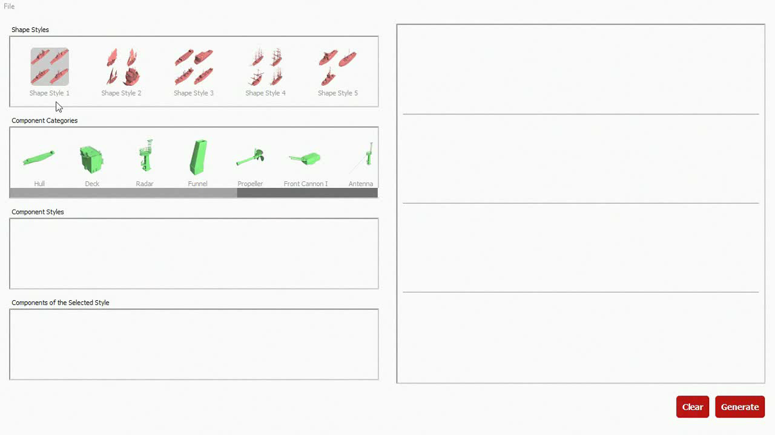
Interactive Shape Synthesis

Slide 48


User Survey
Training
shapes
Synthesized
shapes

Slide 49
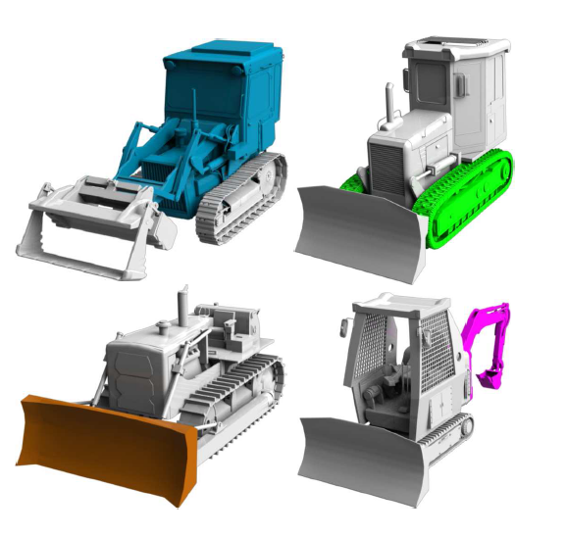
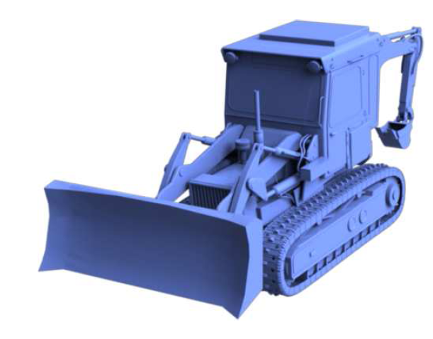
Results
Source shapes
(colored parts are selected for the new shape)
New shape

Slide 50
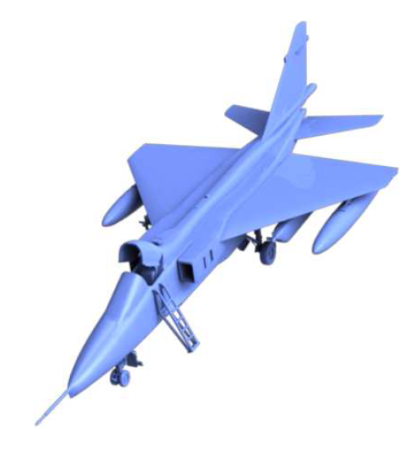
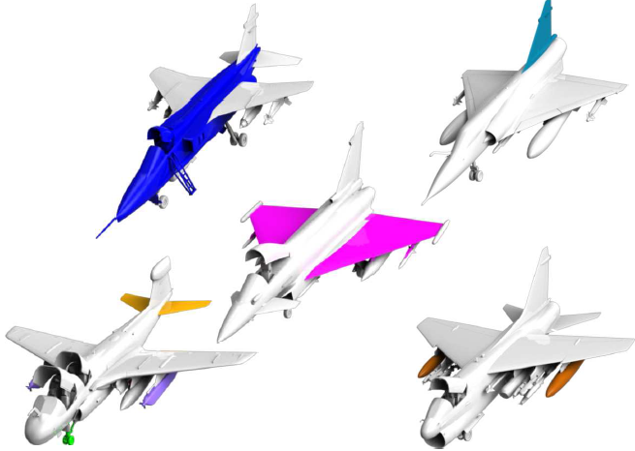
Results
Source shapes
(colored parts are selected for the new shape)
New shape

Slide 51
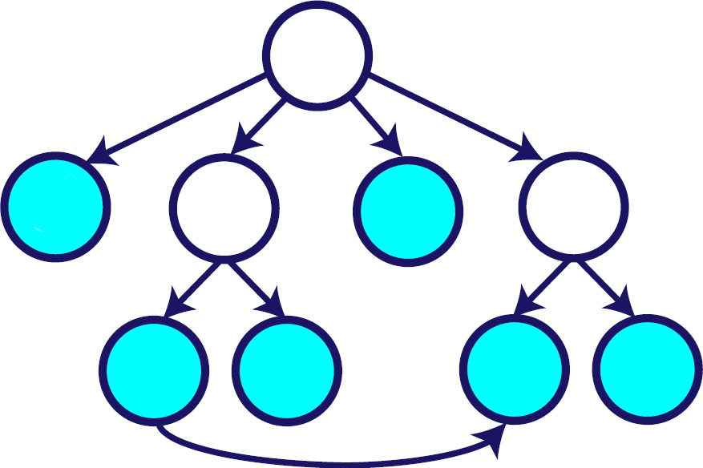


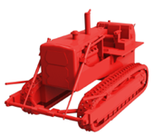
Results of alternative models: no latent variables
R
N₁
S₁
N₂
S₂
C₁
D₁
C₂
D₂

Slide 52
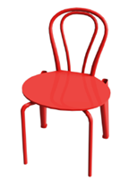
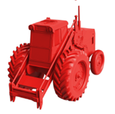

Results of alternative models: no part correlations
R
N₁
S₁
N₂
S₂
C₁
D₁
C₂
D₂

Slide 53
Summary
Generative model of component-based shape synthesis
Automatically synthesizes new shapes from a domain demonstrated by a set of example shapes
Enables shape database amplification or
interactive synthesis with high-level user constraints

Slide 54
Future Work
Our model can be used as a shape prior - applications to reconstruction and interactive modeling
Synthesis of shapes with new geometry for parts
Model locations and spatial relationships of parts

Slide 55



Thank you!
Acknowledgements: Aaron Hertzmann, Sergey Levine,
Philipp Krähenbühl, Tom Funkhouser
Our project web page:
http://graphics.stanford.edu/~kalo/papers/ShapeSynthesis/

